Slide 1




Betagro Shop MVP
Technical Architecture Diagram
January-2023

Slide 2
Executive Summary
This deck outlines Technical Architecture
Our understanding of scope
Technical Architecture
Technical Diagrams
Betagro is looking to launch an online shopping portal for it’s customers to allow them to order Betagro’s products using web and mobile channels and have them delivered conveniently. Betagro’s overall approach is to rollout the portal to cover it’s nationwide shops/stores in a phased manner with a target to start with a pilot phase covering 5(five) shops/stores launching an Minimum viable product (MVP) version.
Betagro team has done the initial requirements assimilation along with wireframes development and seek support from Coforge for the implementation phase of the MVP and subsequent phases.

Slide 3
Part A: Our understanding of scope

Slide 4
Our understanding of scope
Functionality in Scope (MVP) : The following features are considered as the functionality to be implemented as part of the MVP launch
Customer :
Login/Password & Account Management
Home/Landing Page
Product Search/browse and Listings
Product Purchase and Shopping Cart management
Customer Delivery Details
Notifications via SMS/Mail
Shop Manager :
Login/Password & Account Management
Home/Landing Page
Product Search/browse and Listings
Product Purchase (including draft order) and Shopping Cart management – On Customer’s Behalf
Customer Delivery Details – On Customer’s Behalf
Customer Order Listing, Allocation, order download & order status upload
Upload (add, update, delete) and download of Product (including Inventory) and Customer Detail
Notifications via Mail

Slide 5
Our understanding of scope …
Functionality in Scope (MVP) : The following features are considered as the functionality to be implemented as part of the MVP launch
Shop Manager (cont’d) :
Able to maintain substitution product as master using upload.
Able to see substitution product for selection while confirming order
Auto expiry of orders if pass expiry time. Not able to process expired orders.
Part pricing to be maintained on daily basis, orders of past date to be processed based on order date pricing.
Additional Scope : Since this a short duration and fast paced delivery projects, we have factored an additional two hundred man-days of effort apart from the defined fixed functional scope and the deliverables stated in this proposal. This two hundred man days effort can be consumed by Betagro for any Change Request/tech deliverables/support extension/conceptualization of subsequent MVP version etc. basis mutual agreement on efforts between Coforge and Betagro teams.
In case these two hundred man days efforts are not consumed till the completion of the current deliverables and timelines of this Proposal, the remaining effort can be used by Betagro in agreement with Coforge for other activities within a six month period post completion of the current proposed MVP.

Slide 6
Our understanding of scope …
Functionality Not in Scope (MVP) : The following features are not considered to be implemented as part of the MVP launch and would be taken up as a separate activity post MVP Launch.
Payment Options
Promotions & Campaigns, Top Sellers & Suggestions/Recommendations
Other System Integrations
Screens for Master/Housekeeping View/Edit of Products, Customers, Shops
Dashboards and Reporting
Reviews, Shop Setting, Help Center
Development of Static Pages – T&C, Privacy Policy, About, Betagro Recipe
Offline availability of the application or ability to work in offline mode
Execution Scope (MVP) : As the requirements, user stories and wire frames are already defined by Betagro team so the execution scope considered for the MVP launch is as below,
Defining and creating the High Level Architecture and components
Development, Unit Testing & Functional Testing
Vulnerability scan for OWASP Top 10
Support for User Acceptance Testing
Initial Data Setup for MVP Launch
Deployment Support for MVP Launch
Hyper care

Slide 7
Our Understanding of Requirements
Key consideration for Solution
Following are the considerations for the proposed technical solution
Responsive web design
The design should be user friendly and intuitive. It would be informative and easily accessible to the users
The websites can be accessed by multiple devices like desktop, laptop and mobile (through content prioritization)
It should follow W3C guidelines
The application shall be fully compatible with all major web browsers
Key solution approach
Data upload and download in predefined excel format
Data validation before upload from excel file
Cache the static response on node server using “in-memory” caching
Use of Redux for centralizing application state
Highly scalable and extendable

Slide 8
Part B: Technical Solution

Slide 9
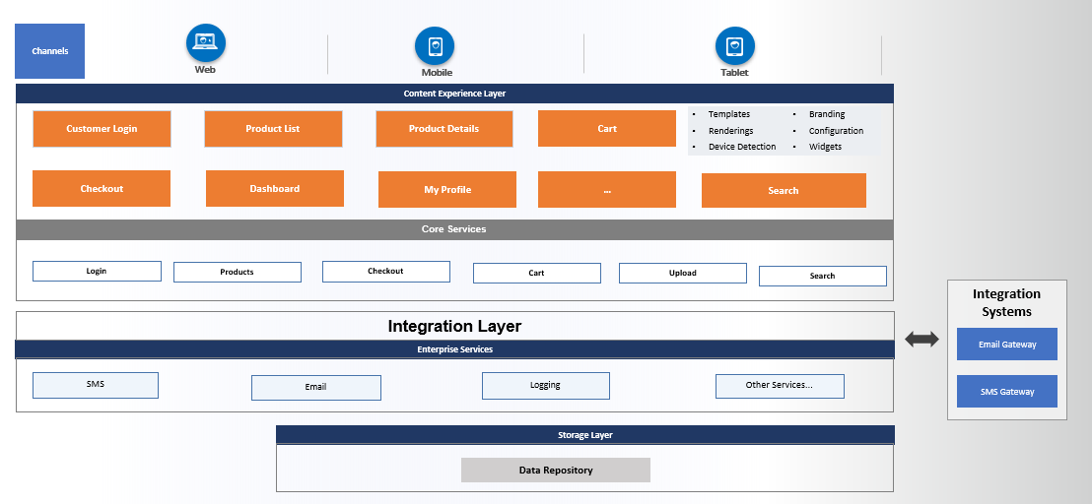
Solution Architecture - Logical

Slide 10
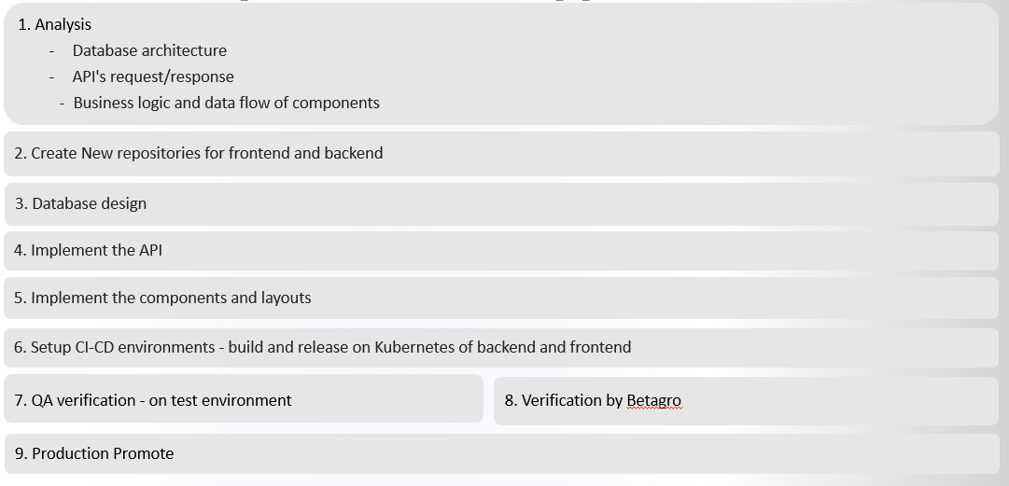
Solution Implementation Approach

Slide 11
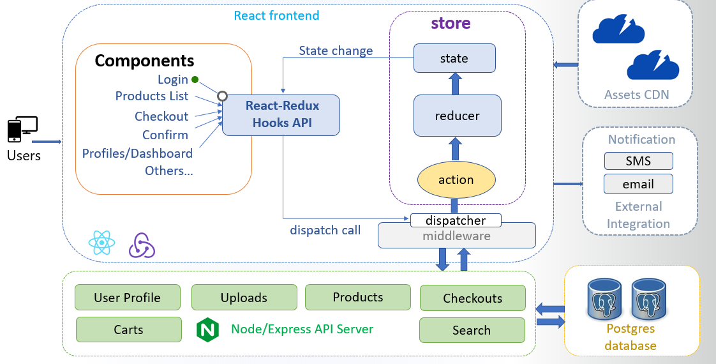
Technical Architecture

Slide 12
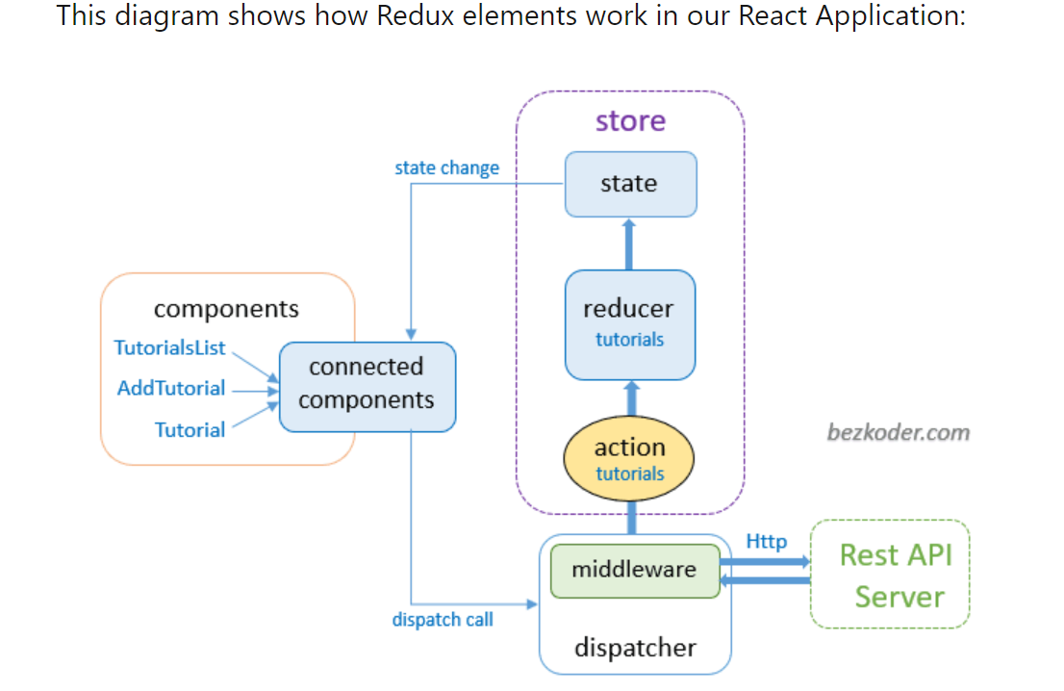
Front End with Redux

Slide 13
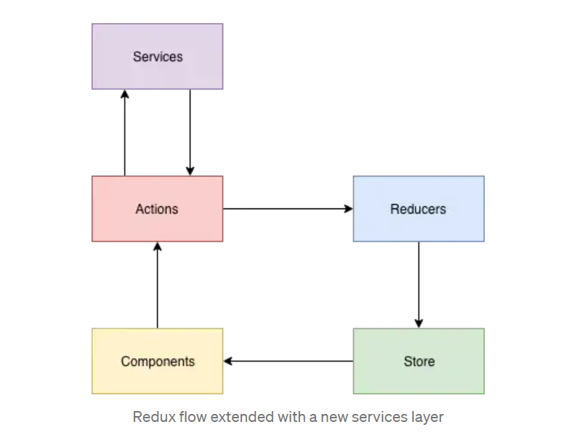
Front end Redux with Service layer
We take the login page
The login page is a functional component, with the validations of phone number ( which is 10 digits only)
The password with 12 characters, with no special character, with a combination of characters and numbers
Its calls the user action
dispatch(userActions.login("phone", payload));
2) The useractions class has the call to the login service by below
return (dispatch) => {
dispatch(request());
userService.login(payload).then(
(user) => {
dispatch(success(user));
localStorage.setItem("authorization", user.data.data.token);
localStorage.setItem("user", JSON.stringify(user.data.data));
history.push("/");
function request() {return { type: userConstants.LOGIN_REQUEST };}
function success(data) {return { type: userConstants.LOGIN_SUCCESS, data };}
function failure(error) {return { type: userConstants.LOGIN_FAILURE, error };}}
3) The reducer call is case userConstants.LOGIN_FAILURE:
return {...state,userLogin: null, userLogin: action.error,}
4)The service class call is
function login(payload) {
const requestOptions = {
method: "POST",
headers: { "Content-Type": "application/json; charset=UTF-8" },
body: JSON.stringify(payload),
};
return Axios.post(REACT_APP_BASE_URL + "/api/users/login", payload,requestOptions)
.then((response) => response)
.catch((error) => error);
}
};
4
2
3
1
(Optional)

Slide 14
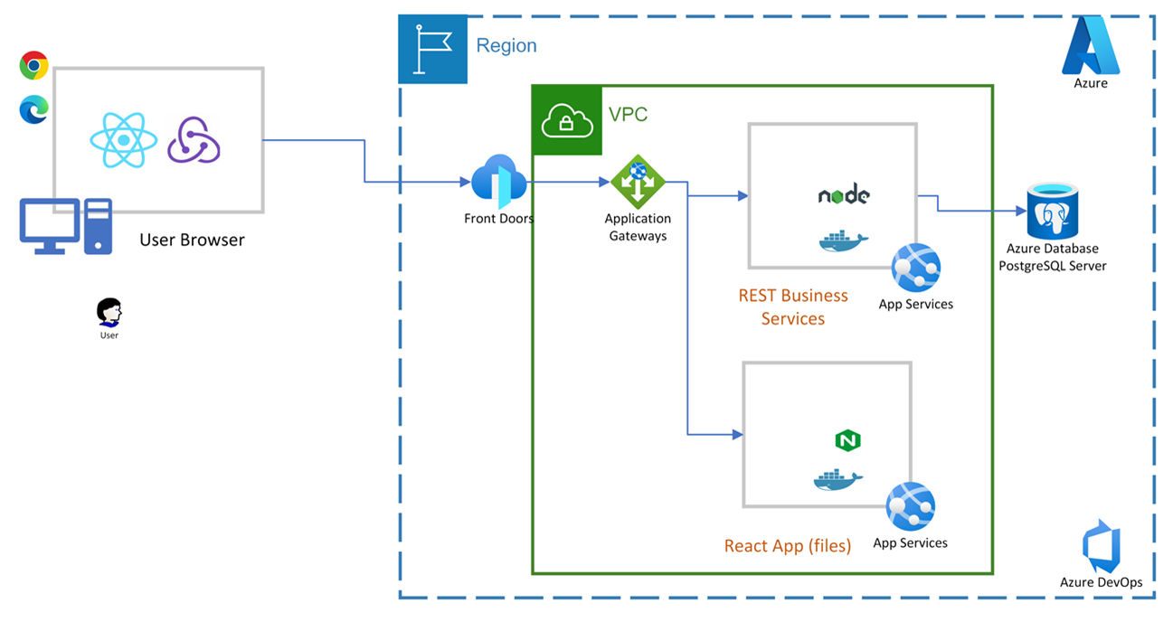
Deployment Architecture - Technical

Slide 15
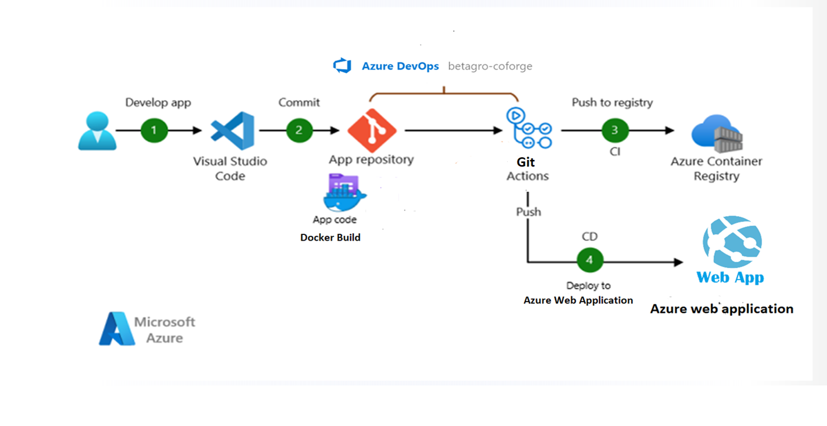
CI-CD Architecture – Technical

Slide 16
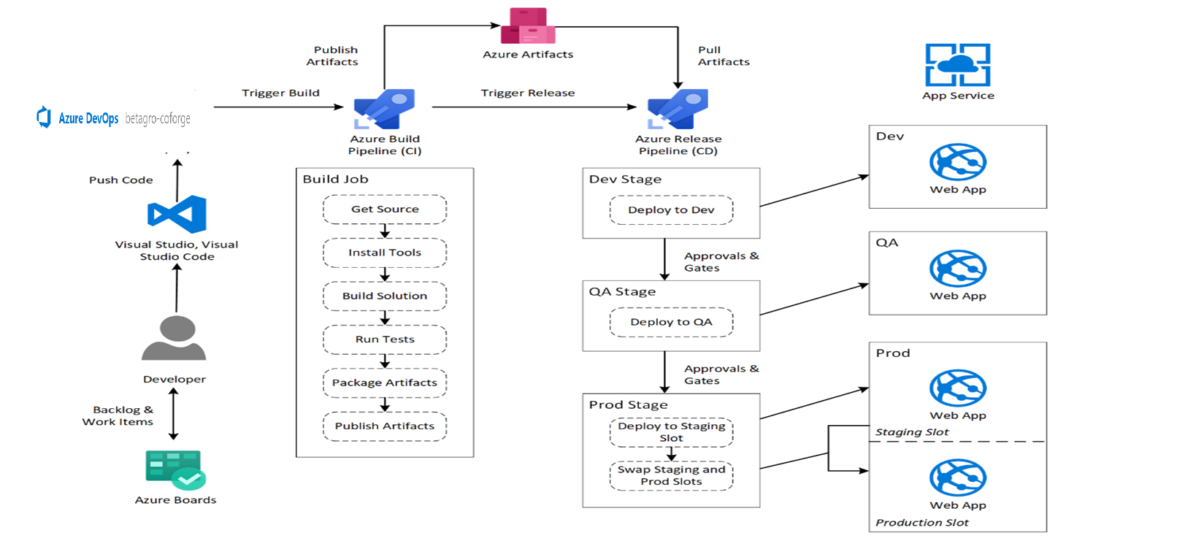
CI-CD Architecture – Technical …

Slide 17
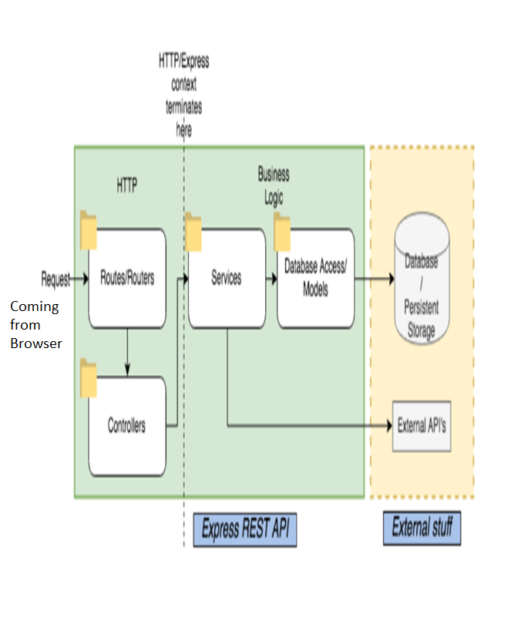
Our Backend Architecture
}
1) Route / login
router.post("/login", User.login, ResponseHandler.process); is the user.route.jsx
2) Controller ( user.login in controller)
exports.login = async (req, res, next) => {
// performe validation .if fails throw error ,
// perform async call to service
[error, result] = await to(UserService.login(req.body));
// return Response
}
3) The service method
const login = async (req) => {
[error, userResult] = await to(User.findOne({where: {phone: req.phone}, raw : true, nest : true}))
//if error return error message
// else success
}
4) The user.findone , is the sequelize call to orm to find in DB
1
3
4
2

Slide 18
Part C: Technical Diagrams with
1) Sequence Diagrams
2) Component diagram
3) Use case diagram

Slide 19
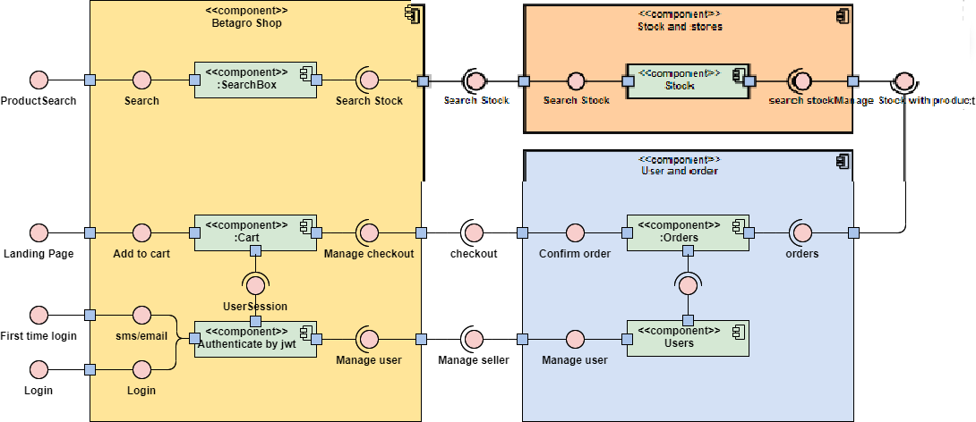
Betagro Component Diagram

Slide 20
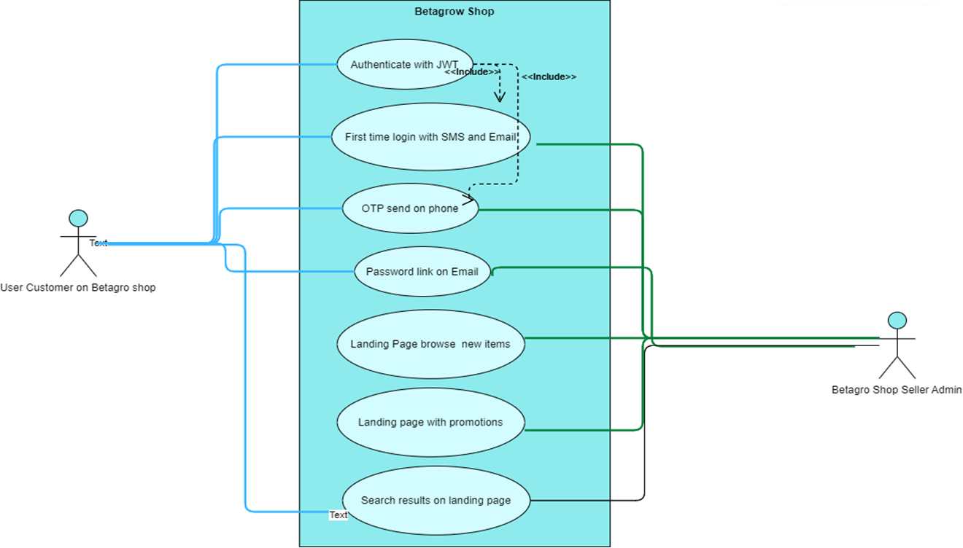
Use case diagram with Customer and Shop Admin Seller

Slide 21
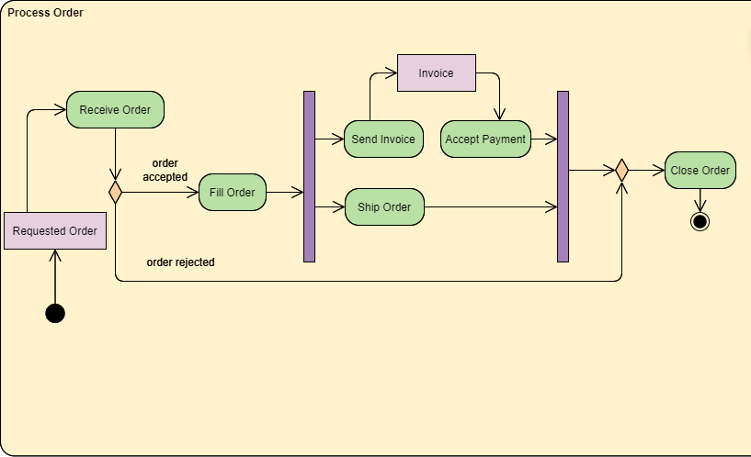
Activity Diagram for Processing Order

Slide 22
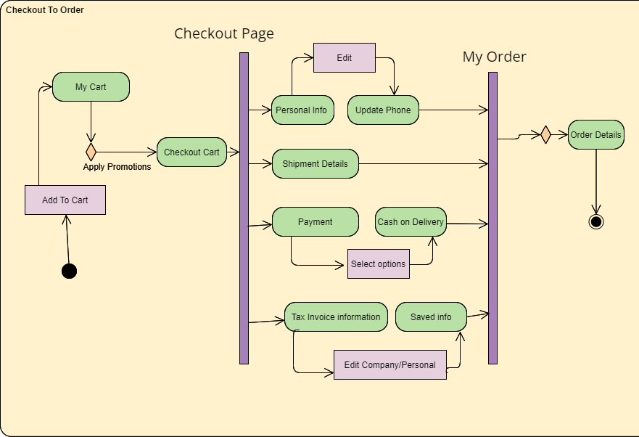
Activity Diagram from Checkout to Order Process

Slide 23
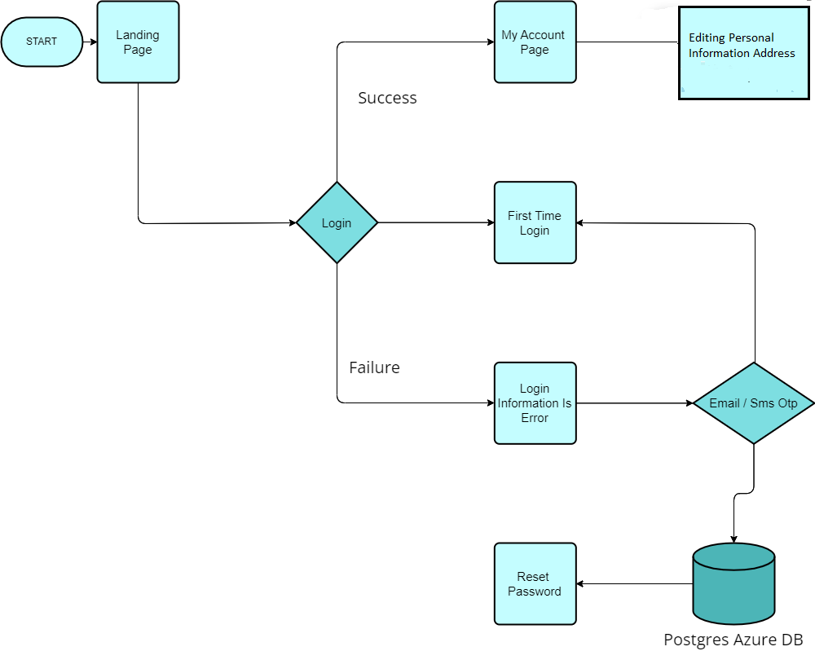
Flow Chart Depicting the Landing page to login and success

Slide 24
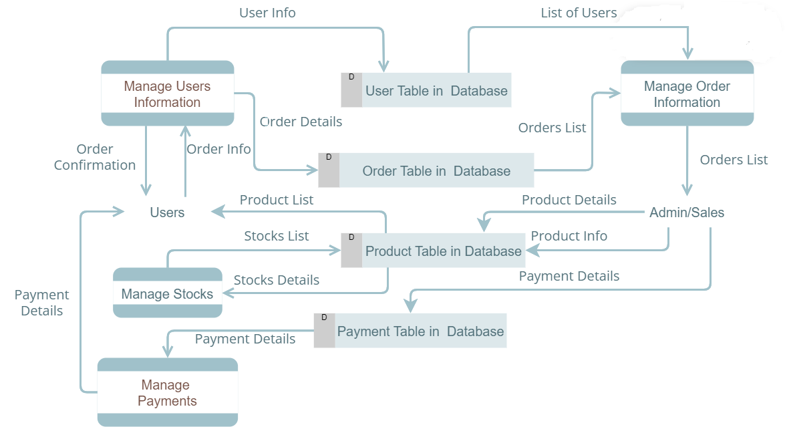
Data Flow Diagram with Major tables in Order and Payments

Slide 25
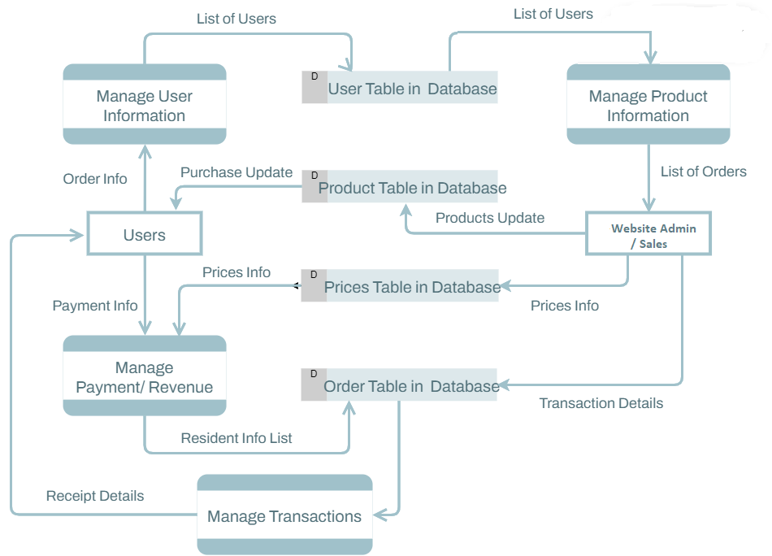
Data Flow diagram Product Prices and Order

Slide 26
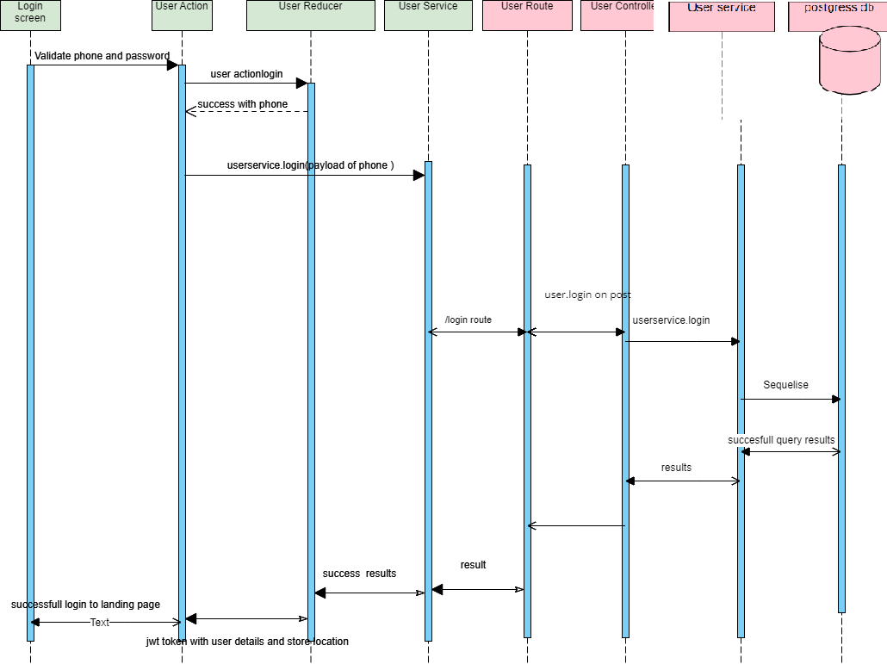
Sequence Diagram depicting, the login functionality tracing from front end screen to backend components

Slide 27
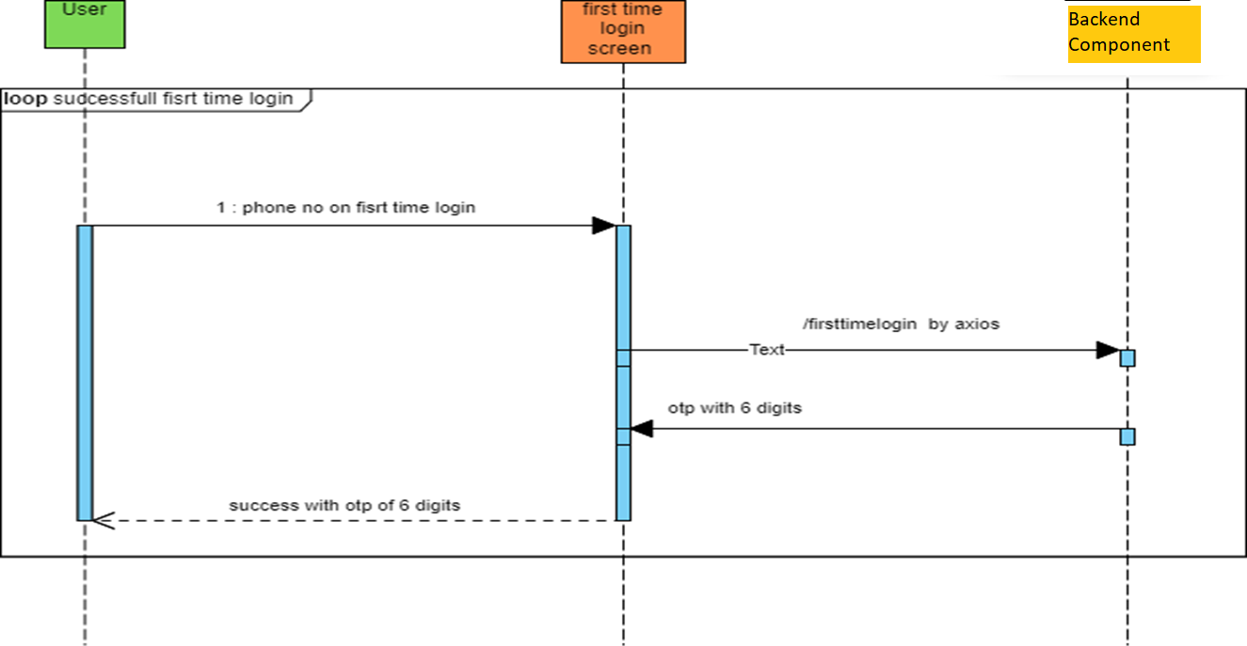
Diagram showing the front-end backend calls on the first-time login screen with phone in OTP

Slide 28
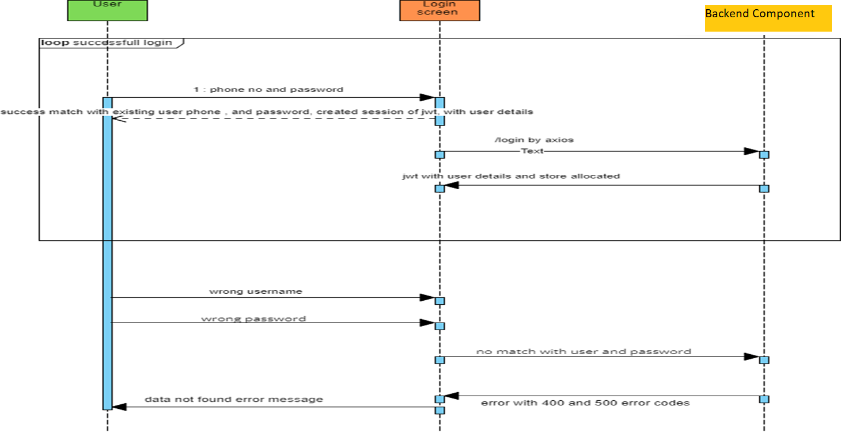
Diagram depicting the successful login and failures

Slide 29
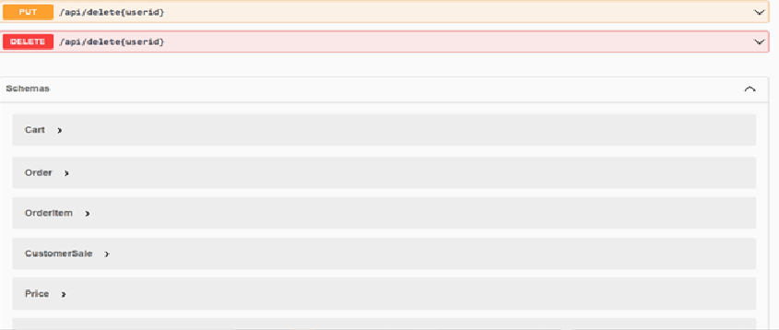
Swagger and Model beans from Backend

Slide 30
Thank you

